Slide 1
DLBA Public Safety Committee
November 22, 2021
DLBA Zoom Session
Mission: Cultivate, preserve and promote a healthy, safe and prosperous Downtown

Slide 2
1. Roll Call
Chair Pat Welch, Vice Chair Isidro Panuco, Josh Beadel, Janice Friend, Sheila Gibbons, Terrence Krieger, Brian McGraw, Rob Smith, Molly Ann Woods

Slide 3
2. Minutes
Action: Approve minutes from October 27, 2021 meeting.

Slide 4
3. Chairperson’s Report
Pat Welch
Chair

Slide 5
COMMITTEE PROJECT GOALS FY 21/22
Fresh Start 2021: Manage the second year of a donation campaign created by the Public Safety Committee to support homeless service providers working with DLBA to get Downtown’s unhoused population off the streets and/or to receive medical, mental health or rehabilitation assistance. Donations occur online and in-person. Committee members recruit businesses and residential towers as hosts of donation boxes over a period of 2-3 months.
Scooter Advocacy: Develop a set of recommendations for advocacy by DLBA related to pedestrian access and safety.
Safety Escort Program: Generate greater awareness and utilization of the safety escort program for residents and businesses. In addition to better publicizing the Safety Escort program, we could also dedicate a shift to safety escorts from high traffic areas to parking garages or other places.

Slide 6
Goal #1: Fresh Start Donation Program (Lead: Sheila Gibbons)
Milestones:
December: Develop a script to use at the neighborhood associations and when calling on businesses.
January: Identify neighborhood associations, set dates to ask for their cooperation and ask for volunteers from the committee to speak at their meetings.
February: Give talks and report back to DLBA committee.
February 16-28: Canvass Downtown and East Village businesses. Several should be scheduled (at least 3). Important to have the boxes available for delivery when businesses agree with placement.
March 1 – April 30: Collection time. Must make weekly run to pick up items in boxes.
May: DLBA to remove all boxes from businesses.
May: Sort and check items and pick a delivery date to partners.

Slide 7
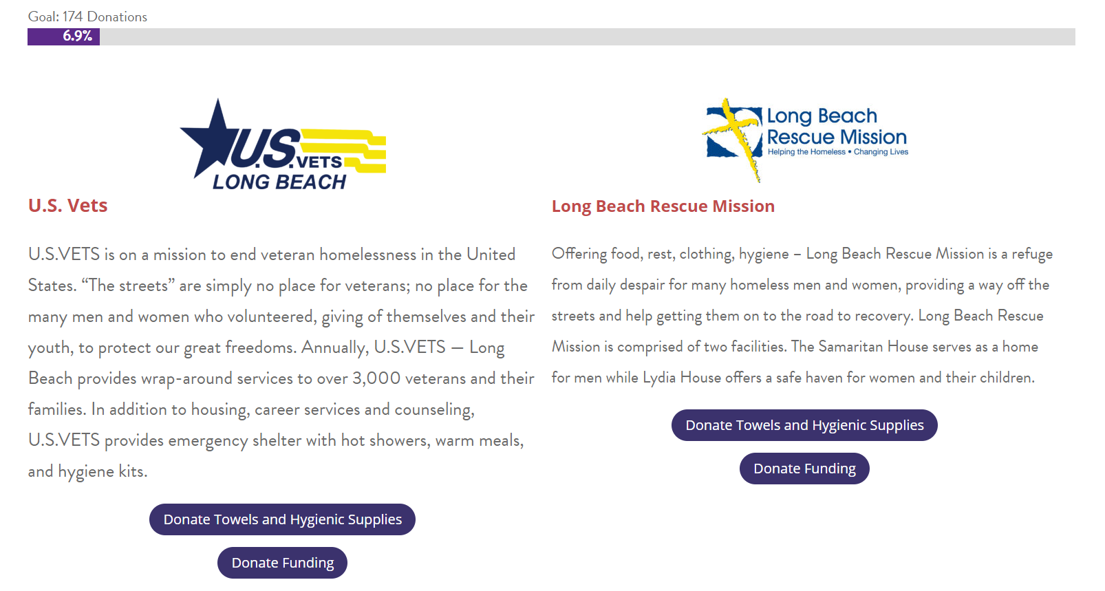
Fresh Start Program – Donations Goal

Slide 8
Fresh Start Campaign Donation Overview
 | Antibiotic/ Disinfectant | Towels (Bath/Hand) | Band-Aids | Soap | Shampoo | Conditioner | Combs | Deodorant | Toothbrushes | Toothpaste | Razors/ Shaving Cream | Feminine Hygiene | Misc
Shannon's |  |  |  | 3 | 1 |  |  |  |  |  | 1 |  | X
Confidential Coffee |  |  |  |  |  |  |  |  |  |  |  | 4
R Bar |  |  |  |  |  |  |  |  | 18 |  |  |  | X
BYO Long Beach |  |  |  | 1 | 16 |  |  |  |  |  |  | 1 | X
Bark! Bark! | 24 | 2 |  |  |  |  |  |  |  |  | 288 |  | X
Willmore | 14 | 11 |  | 30 | 119 | 107 |  | 17 | 59 | 18 | 5 | 5 | X
Amazon | 288 | 292 | 192 | 200 |  |  | 480 |  | 62
Total | 326 | 305 | 192 | 234 | 136 | 107 | 480 | 17 | 139 | 18 | 294 | 10
Goal | 2880 | 1680 | 3840 | 1000 | 1000 | 1000 | 960 | 1000 | 1000 | 1000 | 1000 | 50
Percentage | 11% | 18% | 5% | 23% | 14% | 11% | 50% | 2% | 14% | 2% | 29% | 20%

Slide 9
Goal #2: Scooters and Pedestrian Safety (Lead: Terry Krieger)
Milestones:
Research/Field Visits/Meetings

Slide 10
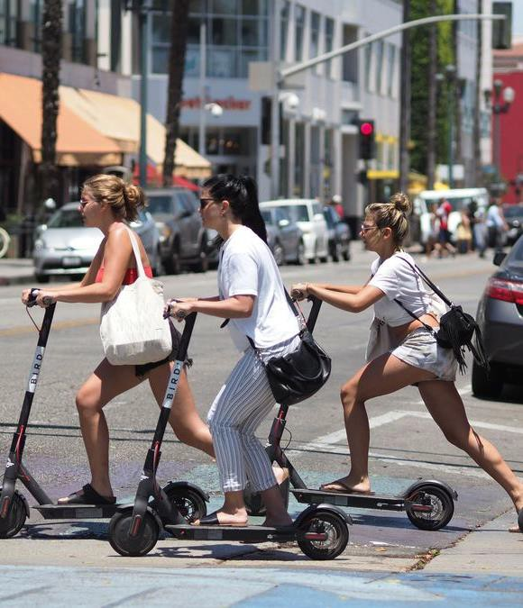
Micromobility Program
Shared Micromobility Permit Program
Permit program launched in August 2020
Three operators launched in 2020 (Lime, Razor, and Bird)
Fourth operator added in January 2021 (VeoRide)
Program allows for a max of four e-scooter permits
Operator permit and per device fees
Permits are issued for 12 months
Permit fee is $25k
Additional fee of $100 per device/vehicle

Slide 11
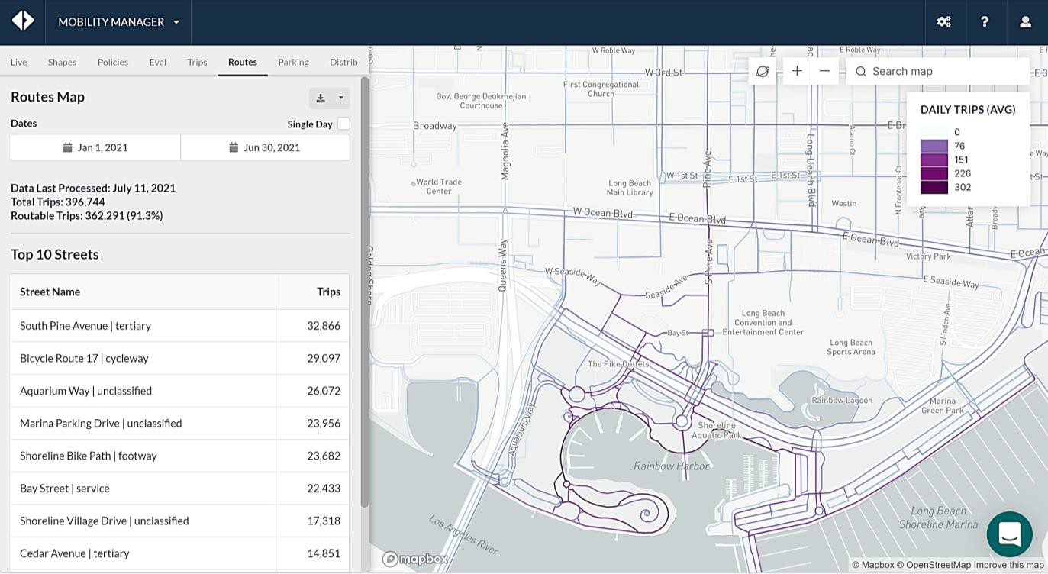
Micromobility Program
Data Management Tool
Populus Data Aggregator
Vehicle trip counts
Geofencing rules
Fleet size management
Popular routes
Heatmap
Daily dashboard
New Features
Real-time GPS data
Policies and rules for operators

Slide 12
Goal #3: Safety Escort Promotion (Lead: Brian McGraw)
Milestones:
Identify promotion locations and partners
Seek permission to promote program from partners
Develop materials/collateral

Slide 13
4. Staff Report
Broc Coward
Steve Be Cotte
Mission: Cultivate, preserve and promote a healthy, safe and prosperous Downtown

Slide 14
Clean and Safe
Review of Downtown Dining and Entertainment District Meeting
LBPD emphasized bartender over service and LEAD training.
LBPD mentioned certain businesses needed to be more mindful of their noise requirements under the Downtown Dining and Entertainment District requirements.
Health Dept reinforced Health Order guidelines around masks and vaccinations.
Health Dept discussed resources becoming available to assist with those experiencing homelessness.
Economic Development shared info about competitive loans and grants.
BC shared info about DLBA’s Safety Escort program.
Update on Safety Ambassador Recruitment and Coverage

Slide 15
5. Public Comment (three minutes on all non-agenda items)
6. Old Business
7. New Business
8. Adjournment
Next Meeting
• Thursday, December 16 at 10:30AM or 4:30PM
• Monday, December 20 at 4 PM

